Slide 1
Subject Name: Software Engineering
Subject Code: (BCSC-0009)
Topic Name: Software Engineering

Slide 2



What is software?
Computer programs and associated documentation

Slide 3
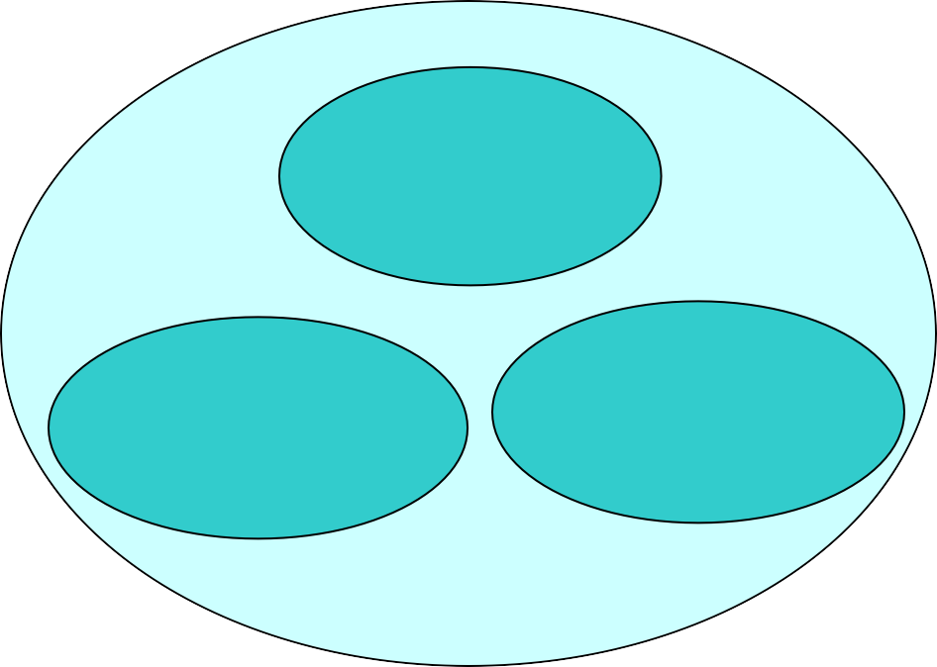
What is software?
Programs
Documentation
Operating Procedures
Software=Program+Documentation+Operating Procedures Components of software

Slide 4


Manuals in Documentation
All the requirements of the software are describe in detail.
Formal Specification
Analysis/Specification
It is drawn in order to define and clarify the boundaries
Context-Diagram
Data Flow Diagrams
It is drawn in order to define and clarify the boundaries
Flow Charts
Design
Entity-Relationship
Diagram
Documentation Manual
Implementation
Source Code Listings
Cross-Reference
Listing
The reference of the code module if it is being used in the software but has been developed by someone else.
Test Data
Testing
Test Results

Slide 5
Software Engineering
The term software engineering is the product of two words, software, and engineering.
The software is a collection of integrated programs.
Engineering is the application of scientific and practical knowledge to create, design and maintain processes.
It is a process of analyzing the requirements of user and then designing, building, and testing software application which will satisfy these requirements.

Slide 6

IEEE Definition of Software Engineering
Software engineering as the application of a systematic, disciplined, which is a computable approach for the development, operation, and maintenance of software.

Slide 7
Boehm’s Definition of Software Engineering
The practical application of scientific knowledge to the creative design and building of computer programs.
It also includes associated documentation needed for developing, operating, and maintaining them.

Slide 8
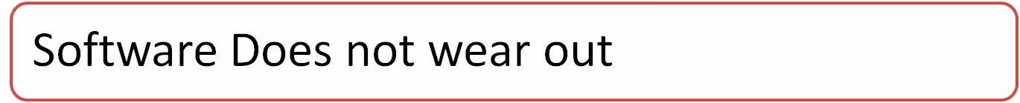
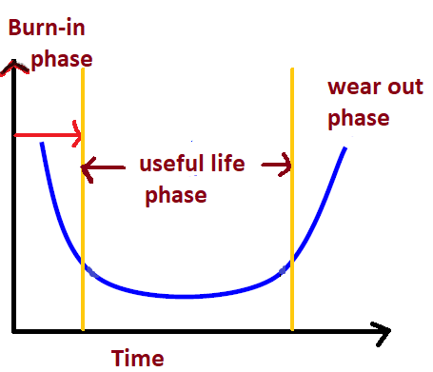

Characteristics of Software

Slide 9
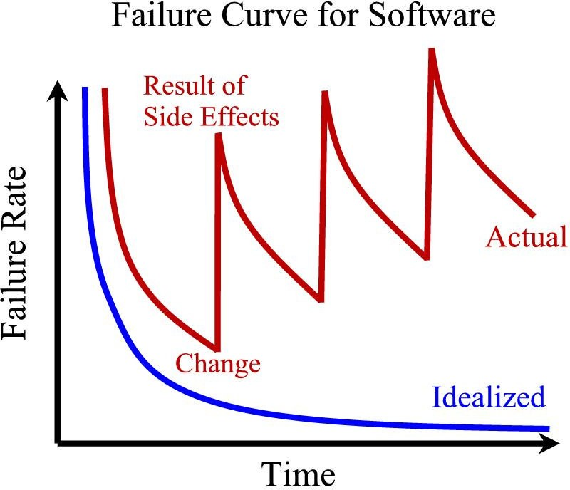
Software Characteristics:
Software is not manufactured
Reusability of components
Software is flexible

Slide 10

Comparison of constructing a bridge vis-à-vis writing a program.
Sr. No | Constructing a bridge | Writing a program
1. | The problem is well understood | Only some parts of the problem are understood, others are not
2. | There are many existing bridges | Every program is different and designed for special applications.
3. | The requirement for a bridge typically do not change much during construction | Requirements typically change during all phases of development.
4. | The strength and stability of a bridge can be calculated with reasonable precision | Not possible to calculate correctness of a program with existing methods.
5. | When a bridge collapses, there is a detailed investigation and report | When a program fails, the reasons are often unavailable or even deliberately concealed.
6. | Engineers have been constructing bridges for thousands of years | Developers have been writing programs for 50 years or so.
7. | Materials (wood, stone,iron, steel) and techniques (making joints in wood, carving stone, casting iron) change slowly. | Hardware and software changes rapidly.

Slide 11
The Changing Nature of Software
System Software
Real Time Software
Engineering and Scientific Software
Embedded Software
Web based Software
Business Software
Artificial Intelligence Software
Personal Computer Software

Slide 12
SDLC
SDLC stands for Software Development Life Cycle and is also referred to as the Application Development life-cycle
It offers a basis for project planning, scheduling, and estimating
Provides a framework for a standard set of activities and deliverables
It is a mechanism for project tracking and control
Increases visibility of project planning to all involved stakeholders of the development process
Increased and enhance development speed
Improved client relations
Helps you to decrease project risk and project management plan overhead

Slide 13
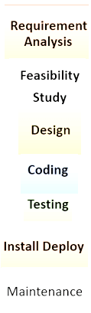
SDLC Phases

Slide 14
Phase 1: Requirement collection and analysis
The requirement is the first stage in the SDLC process. It is conducted by the senior team members with inputs from all the stakeholders and domain experts in the industry.
This stage gives a clear picture of the scope of the entire project and the anticipated issues, opportunities, and directives which triggered the project.
Requirements Gathering stage need teams to get detailed and precise requirements. This helps companies to finalize the necessary timeline to finish the work of that system.
Phase 2: Feasibility study
There are mainly five types of feasibilities checks:
Economic: Can we complete the project within the budget or not?
Legal: Can we handle this project as cyber law and other regulatory framework/compliances.
Operation feasibility: Can we create operations which is expected by the client?
Technical: Need to check whether the current computer system can support the software
Schedule: Decide that the project can be completed within the given schedule or not.

Slide 15
Phase 3: Design
In this third phase, the system and software design documents are prepared as per the requirement specification document. This helps define overall system architecture.
This design phase serves as input for the next phase of the model.
There are two kinds of design documents developed in this phase:
High-Level Design (HLD):
Brief description and name of each module
An outline about the functionality of every module
Interface relationship and dependencies between modules
Database tables identified along with their key elements
Complete architecture diagrams along with technology details
Low-Level Design(LLD)
Functional logic of the modules
Database tables, which include type and size
Complete detail of the interface
Addresses all types of dependency issues
Listing of error messages
Complete input and outputs for every module

Slide 16
Phase 4: Coding
Once the system design phase is over, the next phase is coding. In this phase, developers start build the entire system by writing code using the chosen programming language. In the coding phase, tasks are divided into units or modules and assigned to the various developers. It is the longest phase of the Software Development Life Cycle process.
In this phase, Developer needs to follow certain predefined coding guidelines. They also need to use programming tools like compiler, interpreters, debugger to generate and implement the code.
Phase 5: Testing
During this phase, QA and testing team may find some bugs/defects which they communicate to developers. The development team fixes the bug and send back to QA for a re-test. This process continues until the software is bug-free, stable, and working according to the business needs of that system.

Slide 17
Phase 6: Installation/Deployment
Once the software testing phase is over and no bugs or errors left in the system then the final deployment process starts. Based on the feedback given by the project manager, the final software is released and checked for deployment issues if any.
Phase 7: Maintenance
Once the system is deployed, and customers start using the developed system, following 3 activities occur
Bug fixing - bugs are reported because of some scenarios which are not tested at all
Upgrade - Upgrading the application to the newer versions of the Software
Enhancement - Adding some new features into the existing software

Slide 18
Waterfall Model
The Waterfall Model was the first Process Model to be introduced. It is also referred to as a linear-sequential life cycle model.
Waterfall approach was first SDLC Model to be used widely in Software Engineering to ensure success of the project.
In "The Waterfall" approach, the whole process of software development is divided into separate phases.
In this Waterfall model, typically, the outcome of one phase acts as the input for the next phase sequentially.

Slide 19
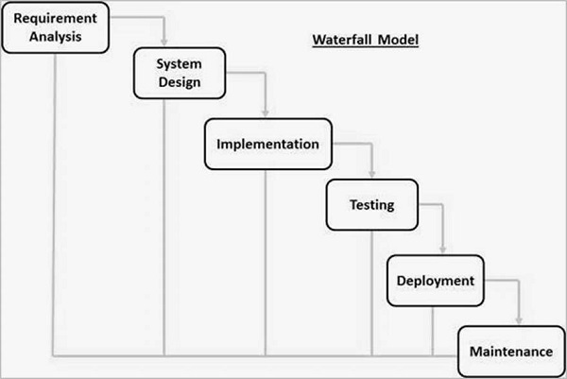

Slide 20
Applications of Waterfall Model
Requirements are very well documented, clear and fixed.
Product definition is stable.
Technology is understood and is not dynamic.
There are no ambiguous requirements.
Resources with required expertise are available to support the product.
The project is short.

Slide 21
Waterfall Model - Advantages
Simple and easy to understand and use
Easy to manage due to the rigidity of the model. Each phase has specific deliverables and a review process.
Phases are processed and completed one at a time.
Works well for smaller projects where requirements are very well understood.
Clearly defined stages.
Well understood milestones.
Easy to arrange tasks.
Process and results are well documented.

Slide 22
Waterfall Model - Disadvantages
No working software is produced until late during the life cycle.
High amounts of risk and uncertainty.
Not a good model for complex and object-oriented projects.
Poor model for long and ongoing projects.
Not suitable for the projects where requirements are at a moderate to high risk of changing. So, risk and uncertainty is high with this process model.
It is difficult to measure progress within stages.
Cannot accommodate changing requirements.

Slide 23

Prototyping model
A prototyping model suggest that before development of the actual software a working prototype of the system should be build first.
A prototype means a sample or we can say that toy implementation of a system.
Prototyping is a technique that allows for a reduced functionality or limited performance of the software to be delivered to the user in the early stages of the development process.
This approach helps to solidify users requirements earlier thereby making waterfall approach more effective.

Slide 24

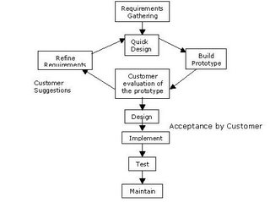

Slide 25
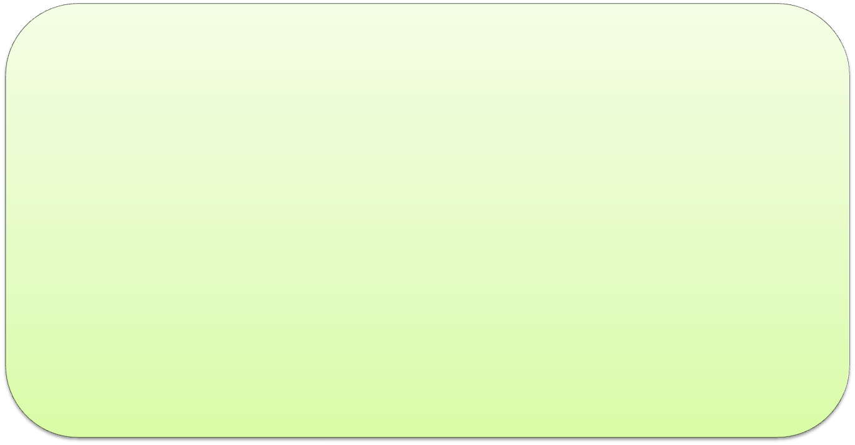
Phases of Prototyping Model
Requirement: In this phase requirement is gathered. In this phase the interaction with user is done to know his/her expectation from system.
Prompt Design: This is very second phase of model. In this phase a simple quick design is formed. This is similar to actual design so that user would be able to get the brief idea about system.
Design/Build of Prototype: This is very important phase because in this phase an actual prototype is build that is totally based on the information collected from prompt design.

Slide 26
Phases of Prototyping Model(Cont..)
Initial user evaluation
In this stage, the proposed system is presented to the client for an initial evaluation. It helps to find out the strength and weakness of the working model. Comment and suggestion are collected from the customer and provided to the developer.
Refining prototype
If the user is not happy with the current prototype, you need to refine the prototype according to the user's feedback and suggestions.
Implement Product and Maintain
Once the final system is developed based on the final prototype, it is thoroughly tested and deployed to production. The system undergoes routine maintenance for minimizing downtime and prevent large-scale failures.

Slide 27

Prototyping is particularly useful in the development of very large system where it is difficult to describes all the requirements and it also helps to examine the technical issues associated with the product development.
This model begins with the requirement gathering. Developers and customers meet and define the overall objectives for the software, identify whatever requirements are known and outline areas where further definition is compulsory.
A quick design then occur it focuses on a representation of these aspects of the software that will be visible to the user.

Slide 28

Advantages of Prototyping model:-
It provides better understanding of the customer needs.
It helps to examine the technical issues associated with the product development.
This method is useful in the development of very large system.
It solidify user requirements thereby making the waterfall approach more effective.

Slide 29
Disadvantages of Prototyping model:-
In some cases, prototype has to be discarded
because some might argue that the cost involved
is higher.
Use of inefficient, inaccurate, or dummy function
may not provide the actual processing.
The developer often makes implementation
compromises, in order to get a prototype working
quickly.

Slide 30
Iterative Enhancement Model
1:It is also known as increment model.
2:It comprises the features of waterfall model in iterative manner.
3:At each iteration, modifications in design are made and new functionalities are added.
4:The basic idea is to develop a product in iterative and incremental manner.
Iterative: Repeated Cycles
Incremental: Smaller portion at a time.

Slide 31

The Incremental Model or Iterative Enhancement Model:-
Generally the phases occur in the same order as in the waterfall model but they may conducted in the several cycles.
A usable product is released at the end of each cycle.
With each release providing additional functionality therefore every iteration would therefore deliver a product with incremental capabilities.

Slide 32
Iterative model deliver and operation quality product at each release but one that satisfies only a subset of the customer requirements.
The complete product is divided into releases and the developer deliver the product release by release.

Slide 33
Iterative Enhancement Model
Iteration 1
Iteration 2
Iteration 3
Design
&
Develop
Testing
Implementation
Requirements
Design
&
Develop
Testing
Implementation
Implementation
Design
&
Develop
Testing

Slide 34
Advantages:-
It is particularly useful when staffing is unavailable for a complete implementation. Early increment can be implemented with fewer people if the core product is well received then additional staff can be added.
2) this approach also has advantages specially for in- house development where it is ensure that the user has something to start with.

Slide 35
Disadvantages:-
The potential danger of this method is that the iteration may never end and the user may never really get the final product.
2) another problem with this type of project comes in generating the business contract i.e how with the cost of additional features being determined and negotiated.

Slide 36
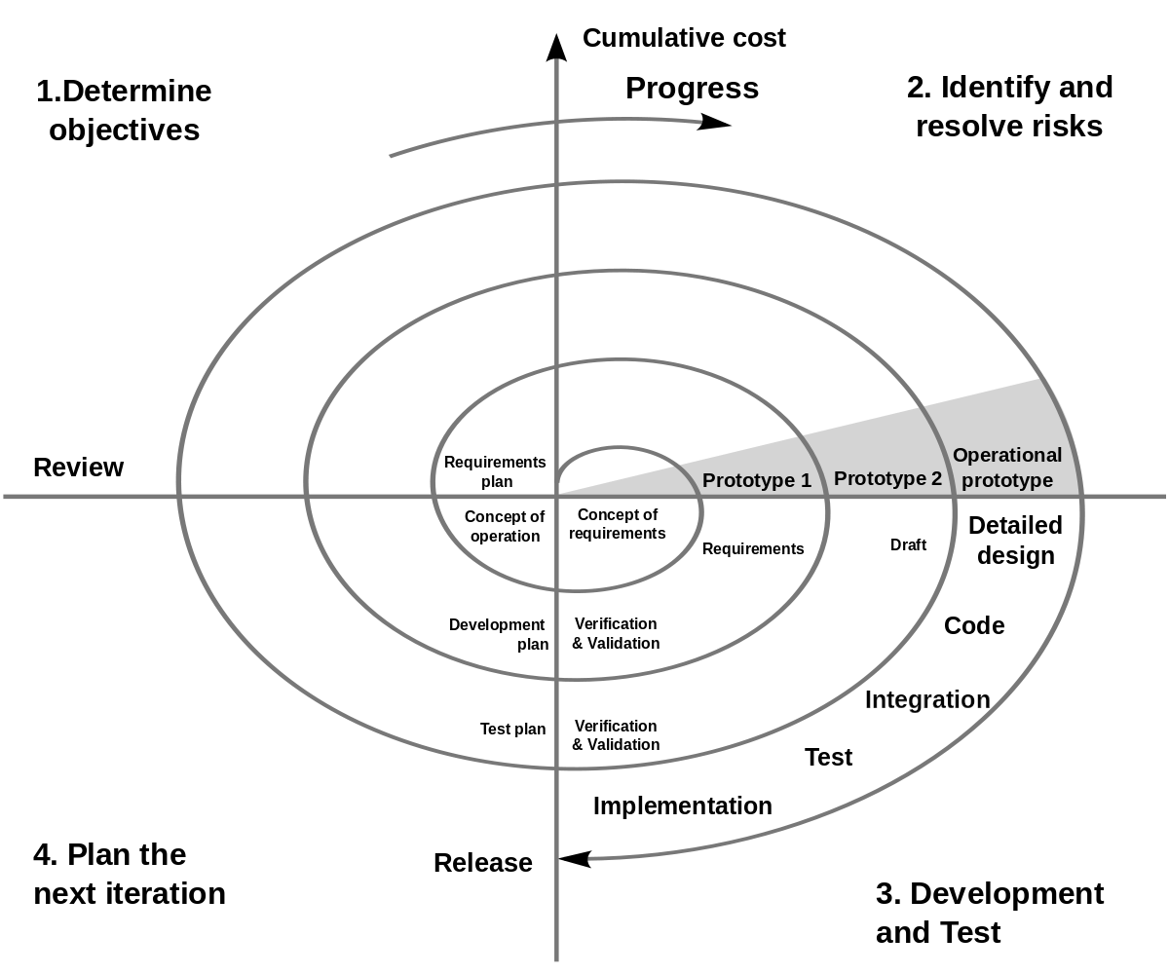
Spiral Model

Slide 37
Spiral Model
1:Determination of Objectives and identification of solution: All the requirements are collected from users and the objectives are identified. Analysis of objective is done at each phase.
2:Identification the solution of risk: In this quadrant the main task is to collect all possible solutions and select optimal solution among those. Now next task is to evaluate the risk associated with that solution. If risk persist then it is solved with the best method.
3:Development and Test: In this quadrant, all the features which have been identified are now tested for verification purpose.
4:Planning of next phase: In this phase product is reviewed and planning for next phase is started.

Slide 38
Spiral Model-Advantages
1:In spiral model risk handling and risk analysis is possible at every phase, because there is continuous and repeated development process.
2:If additional functionalities are required then these can be added or done at later stage.
3:Development process is fast.
4:Customer can observe the development of product at early stage.
5:It is suitable for large product.

Slide 39
Spiral Model-Disadvantages
1:If we compare this model with other SDLC models than it is complex.
2:Due to its complex nature expert resources are required which lead to high cost. So we can say that it is not suitable for small product.
It has so many intermediate phases so there are large documents in it.
Estimation of time is not so easy at the starting of this model due to unknown number of phases.

Slide 40

Agile Software Development Model
It is combination of iterative and incremental process
Basically, the main motive of agile is that every project must be dealt with different approaches/methods.
In agile task is broken into small iterations.
Plan for each iteration is clearly defined in advance.
The motive to divide project in small part is to minimize risk and to deliver the project on time.

Slide 41
Agile Software Development Model
As development process is iterative, so the project may be executive in very short time period and no long planning is required.
There is a testing phase with each iteration.
Both testers and developers work together.

Slide 42
Phases in agile Model
Require
Requirement gathering
Design document & prototype
Construction/Iterations
Identification of defect and bugs(Testing)
Deployment
Feedback

Slide 43
Agile Software Development Model
1: Requirements gathering: This is most important phase of any model. All the future requirements of product is collected ,evaluated .Based on this information the feasibility of project is evaluated.
2:Design the requirements: After requirement gathering design of requirement is started. This design can be achieved using various data flow diagram.
3:Construction/ iteration: In this phase team members start working on assigned module or part.
4:Testing: This is the phase related to quality assurance. This is done to check the working capability of the product and to make a comparison between expected and actual output.

Slide 44
Agile Software Development Model
5: Deployment: In this phase product is issued to work in user’s environment.
6:Feedback: This is last step in which team receive feedback from user and work on that.

Slide 45
Scrum
This is a agile methodology or we can say agile framework.
It is widely used by software development team.
Its main focus is on time business delivery(two to three week time).
Basically scrum is used where requirement is rapidly change, because due to its flexibility its quickly adopt changes.

Slide 46
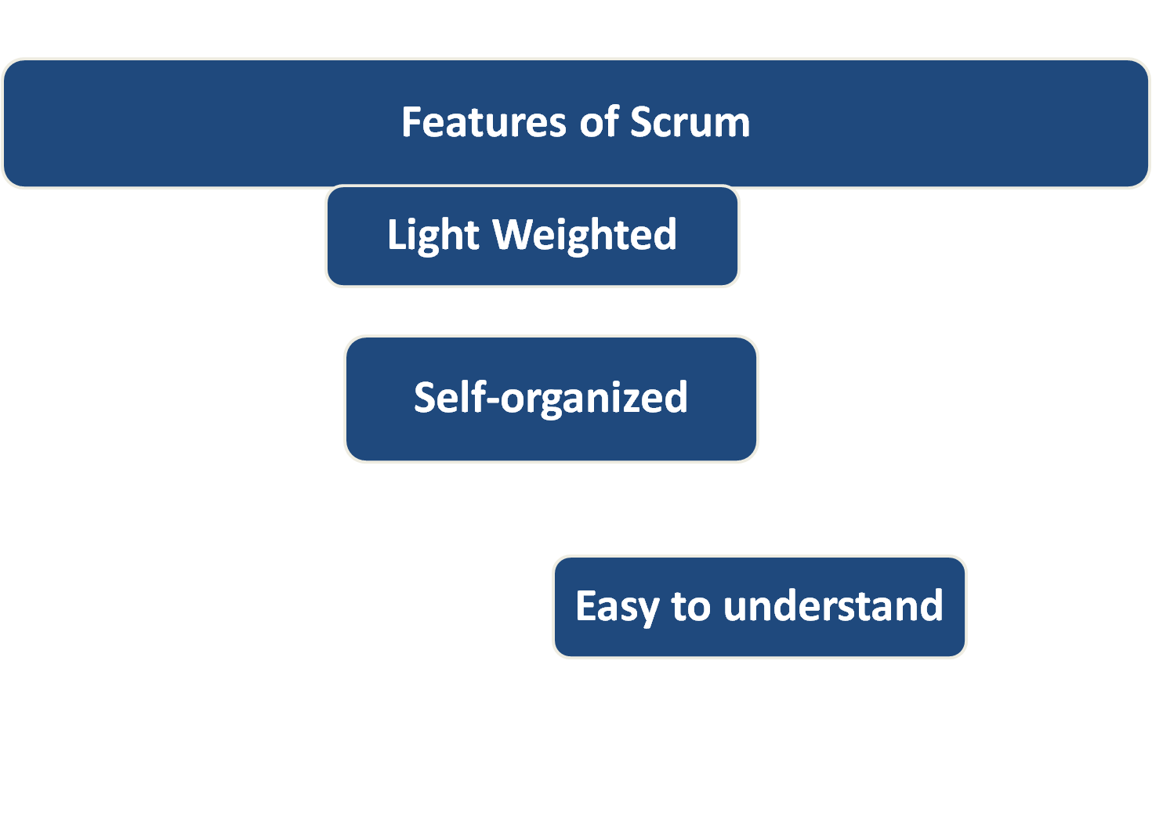

Slide 47
Scrum(cont…)
The meaning of light weighted is that the overhead of the process is kept as small as possible.
Self organization principles to complete work and to coordinate with other teams.

Slide 48
Scrum(cont…)
Scrum is a framework used to manage product development.
Scrum is run on time boxes of one month or less.
Scrum team consist of product owner, development team and scrum master.
Product owner: They are responsible for maintaining the product backlog and ensuring the entire scrum team understands the overall vision for the product
Development team: It is a team who has every thing to deliver the product on time without a dependency on outsider team. It is a self-organizing team.

Slide 49
Scrum(cont…)
Scrum master:
Responsible to ensure scrum process.
Responsible to train the team as and when required.
Responsible to remove all barriers.
Responsible for the practice of defined rules.

Slide 50
Sprint: Scrum project is divided into small iterations. Normally the duration of these iterations is one to three week. This is called Sprint.
Sprint Planning: Meaning of Sprint planning is to give answer.
What,we are doing?
How, we are doing?

Slide 51
Daily Scrum: Daily Scrum is a 15-minute time-boxed event for the Development Team to synchronize activities and create a plan for the next 24 hours.
Sprint Review: The sprint review is an informal meeting with the development team, the scrum master, the product owner and the stakeholders will attend.
Sprint Retrospective: Sprint Retrospective is an opportunity for the Scrum Team to inspect itself and create a plan for improvements to be enacted during the next Sprint. The Sprint Retrospective occurs after the Sprint Review and prior to the next Sprint Planning.

Slide 52
Product Backlog: A product backlog is a list of the new features, changes to existing features, bug fixes, infrastructure changes or other activities that a team may deliver in order to achieve a specific outcome.
Sprint Backlog: The sprint backlog is a list of tasks identified by the Scrum team to be completed during the Scrum sprint.
Increment: The Increment is the sum of all the Product Backlog items completed during a Sprint and the value of the increments of all previous Sprints

Slide 53
Sprint
Scrum project is divided into small iterations. Normally the duration of these iterations is one to three week. This is called Sprint.
It makes project more manageable.
Due to its flexibility it adopt changes easily.

Slide 54
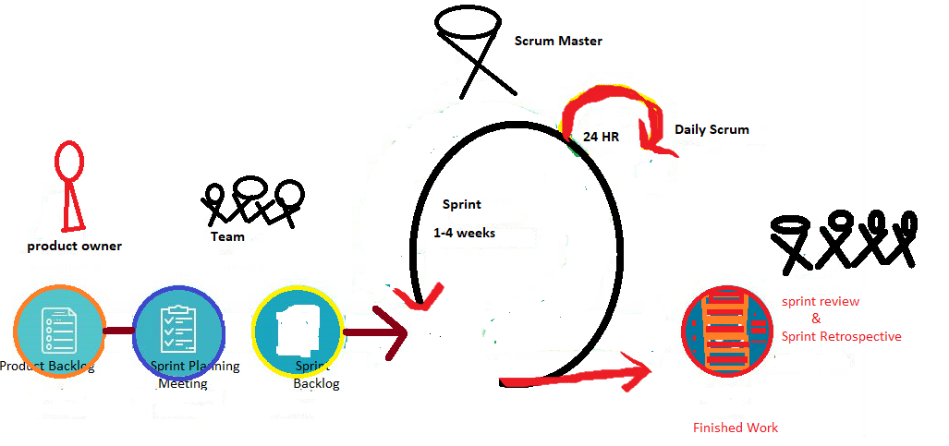
Sprint Backlog
Sprint
planning
meeting
Product backlog

Slide 55
Sprint Planning
Sprint planning is a collaborative event. Which can be done with the collaborative effort of whole Scrum team.
It is a time boxed to a maximum eight hours for a one month Sprint or Sprint planning should be constrained no more than two hours for each week of the sprint.
It provides some flexibility to developer regarding the functionality implemented within Sprint.
Meaning of Sprint planning is to give answer.
What are we doing?
How are we doing?

Slide 56
Sprint Lifecycle
Planning
Planning
Implementation
Review
Retrospective

Slide 57

Sprint Planning Meeting
The main motive of Sprint planning meeting is to provide structure, guidelines, criteria, expectations and define backlog for forthcoming backlog.
There are following people involved in Sprint planning meeting.
Product Owner: This is most demanding position. Product owner is responsible for managing the product backlog and product backlog visibility. product owner looks at the project from the customer’s perspective. product owners are responsible for managing product backlogs
Scrum Master: Scrum Master is responsible to motivate the team in tough time and also responsible for timely completion of project. Scrum Master mainly focus on team’s operation.
Scrum master improve the quality of product.
Development Team:It is a group of cross functional members dedicately work on product to be deliver. Member of this team are self organizing. Individual members of this team may have specialized skills and areas of focus.

Slide 58
Product Backlog
It is compiled of all the things that must be done to complete the whole project.
Product owner owns product backlog.
The product backlog acts as an input to the sprint backlog when comes to functionality
There are also bugs/issues, epic, user stories and themes are included in the product backlog

Slide 59

Subject Name
Software Engineering
Topic : Requirement Engineering
Department of Computer Engineering & Applications

Slide 60

Requirement Engineering
Requirement Engineering is mainly focused on discovering -
what is to be developed?
How it should be developed?
Main aspects are:
What does the customer want?
What does the customer require in order to use the system?
What will be the software’s impact on user be?

Slide 61
It’s a critical stage of the software process as errors at this stage will reflect later on the next stages, which definitely will cause you a higher costs.
What requirement process ensure?
It ensures that our software must meet the user expectations and ending up with a high quality software.

Slide 62
What should we do when we are going to develop a software?
To develop the software system we should have clear understanding of Software system.
To achieve this we need to continuous communication with customers to gather all requirements.

Slide 63

Requirement Engineering Process
It is a four step process, which includes:
Requirement Elicitation
Requirements Analysis
Requirement Documentations
Requirements Review

Slide 64

Requirement Elicitation
It is the process to find out the requirements for an intended software system by communicating with client, end users, system users and others who have a stake in the software system development.

Slide 65

Requirement Analysis
It is a process to determine the expectation of user.
Requirement must be detailed and relevant
These requirements are also called functional specification of a software.

Slide 66

Requirement Documentations
Generally we can say that software requirement document is a description of features and functionalities of targeted application/software
Software requirement documents specify that what the software/application will do.

Slide 67

Requirement Review
It is a review process to ensure that all requirements are identified properly.
It is a process in which both parties involve.

Slide 68
Types of requirements
Known Requirements
Unknown Requirements
Undreamed Requirements
Something on which the stakeholder believes to be implemented
Forgotten by stakeholders as they are not needed right now.
Stakeholder may not be able to think due to lack of domain knowledge

Slide 69
Feasibility study
What is feasibility study?
It is a analysis that accounts all the factors, i.e economic, technical, legal and others with are necessary for the completion of a project successfully.

Slide 70
Feasibility study focuses on
Is the concept of project is workable
Should we proceed with the proposed project idea
To find out the estimated cost and schedule of project
Identification of all the major risks
Stability of requirements
Identification of new possibilities through investigative process

Slide 71
References
1:K.K. Aggarwal &Yogesh Singh
2:https://www.tutorialspoint.com/

Slide 72

Software Requirement Specification
It is a description of a software system to be developed.
A software requirements specification (SRS) is a detailed description of a software system to be developed with its functional and non-functional requirements.
The SRS is developed based the agreement between customer and contractors. It may include the use cases of how user is going to interact with software system.
The software requirement specification document consistent of all necessary requirements required for project development.
To develop the software system we should have clear understanding of Software system.
To achieve this we need to continuous communication with customers to gather all requirements.

Slide 73

Requirement Elicitation
Requirements Elicitation is the process to find out the requirements for an intended software system by communicating with client, end users, system users and others who have a stake in the software system development.

Slide 74

Requirement Elicitation Process
Requirement gathering
R
Requirement Organization
Negotiation &Discussion
Requirement Specification

Slide 75

Requirement Elicitation Process
Requirements gathering
The developers discuss with the client and end users and know their expectations from the software.
Organizing Requirements
The developers prioritize and arrange the requirements in order of importance, urgency and convenience.

Slide 76

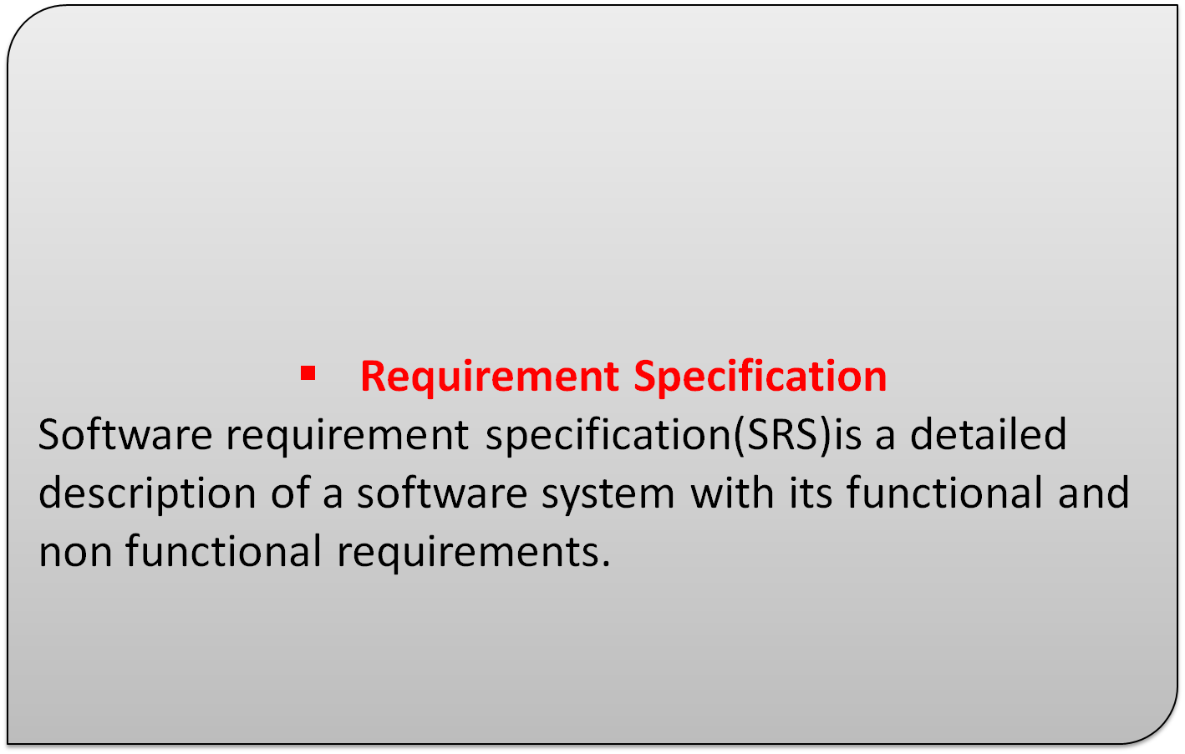
Requirement Elicitation Process(cont..)
Negotiation & discussion
If requirements are ambiguous or there are some conflicts in requirements of various stakeholders, if they are, it is then negotiated and discussed with stakeholders. Requirements may then be prioritized and reasonably compromised

Slide 77
Functional Requirements
It specify the behavior of a system.
What software system will do.
Non-Functional Requirements
It is related to quality of a system.
How software system will do .

Slide 78

Non-Functional Requirements(Contd..)
Generally Non-functional requirements fall into many areas some of them are as given below.
Efficiency
Usability
Availability
Portability
Flexibility
Maintainability

Slide 79

Requirement Elicitation Techniques
Interviews
Interviews are strong medium to collect requirements. Organization may conduct several types of interviews
Structured (closed) interviews
Where every single information to gather is decided in advance
Follow pattern and matter of discussion.
Non-structured (open) interviews
Where information to gather is not decided in advance These are more flexible and less biased.

Slide 80
Interview(cont..)
Oral interviews
Written interviews
One-to-one interviews
which are held between two persons across the table.
Group interviews
Held between groups of participants.
Help to uncover any missing requirement as numerous people are involved.

Slide 81

Requirement Elicitation Techniques
Brainstorming
It is a group technique
So many peoples are involved in this activity so lots of new ideas are shared
Every idea/view is documented properly so that every one would be able to see these ideas.

Slide 82

Requirement Elicitation Techniques
Brainstorming
A detailed report of all is prepared which consist list of requirements and their priority.
As it’s a group activity so there are chances of group conflict and bias. To handle such circumstances a highly trained facilitator is required.

Slide 83

Requirement Elicitation Techniques
FAST
It stands for Facilitated Application Specification Technique.
Due team oriented nature of this approach it is somewhere similar brainstorming.
Main motive of this approach is to fill the gap between the customer and developer.
Each participants has to prepare his/her list.
All different lists are combined and redundant lists are removed.
Sub teams are made for mini specifictions.

Slide 84

Requirement Elicitation Techniques
QFD
It stands for Quality Function Deployment.
Main priority of this technique is customer satisfaction.
It is obvious ,if customer requirements are fulfilled then customer will be satisfied.

Slide 85

Requirement Elicitation Techniques
QFD(Cont..)
There may be various types of customer requirements.
Normal Requirement
In it all the requirements of software (which is to be developed) are discussed with customer.
Expected requirements
Requirements which are not explicitly stated by customer.(e.g:Security from unauthorized access)

Slide 86

Requirement Elicitation Techniques
QFD(Cont..)
Exciting Requirement
These are beyond the expectation of user.
In it developer adds some unexpected features to make customer more satisfied.

Slide 87
References
1:K.K. Aggarwal &Yogesh Singh
2:https://www.tutorialspoint.com/

Slide 88
Use case diagram
Use case diagrams are graphical representations
Use case diagram is the primary form of system/software requirements for a new software program underdeveloped.
Use cases specify the expected behavior (what), and not the exact method of making it happen (how).
Use cases once specified can be denoted both textual and visual representation (i.e. use case diagram).
A key concept of use case modeling is that it helps us design a system from the end user's perspective.
It is an effective technique for communicating system behavior in the user's terms.

Slide 89
Use case diagram(cont..)
Use case diagrams are typically developed in the early stage of development and people often apply use case modeling for the following purposes:
Specify the context of a system
Capture the requirements of a system
Validate a systems architecture
Drive implementation and generate test cases
Developed by analysts together with domain experts

Slide 90
Components of use case approach
Actor
An actor or external agent, lies outside the system model, but interacts with it in some way.
Actor-------> Person/Machine/Information System
Actor may be distinguished as primary actor and secondary actor
Primary Actor: Primary actor is one having a goal requiring the assistance of the system.
Secondary Actor: Secondary actor is one from which system needs assistance.

Slide 91
Actor
Actor has responsibility toward the system (inputs) and actor has expectations from the system (outputs).
Actors can be a human user, some internal applications, or may be some external applications.

Slide 92
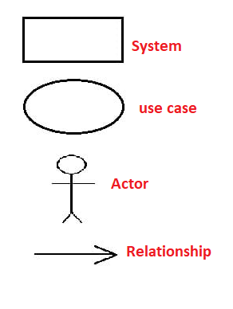
Notations

Slide 93


Components of use case diagram
Actor : Who interacts with the system
Use case : Functionality and services provided by the system
Relationship : Relation between actor and use cases
System boundary
System boundary
Use case
Actor
-- Actors appear outside the rectangle.
-- Rectangular box represent the System
--Use cases within rectangle providing functionality.
--Relationship association is a solid line between actor & use cases.
Use case
Actor
Use case
6

Slide 94
Components of use case approach(cont..)
Use Case
A use case is initiated by a user with a particular goal in mind, and completes successfully when the goal is satisfied.
It describes the sequence of interactions between actors and the system necessary to deliver the services that satisfied the goal.
So, we can say that
A use case captures who(actor) does what (interacting) with the system, for what purpose(goal),without dealing with system internals.

Slide 95
Components of use case approach(cont..)
Communication link
The participation of an actor in a use case is shown by connecting an actor to a use case by a solid link.
Boundary of the system
The system boundary is an entire system.

Slide 96
Use Case Example
Generalization Relationship
A generalization relationship means that a child use case inherits the behavior and meaning of the parent use case.
Search
Search by author
Search by title

Slide 97
Use case diagram for Result Management System
Maintain Student Details
Maintain Subject Details
Data Entry Operator
Maintain Result Details
Login
Teacher
Administrator/DR
Generate Result Reports
View Results
Student
36

Slide 98
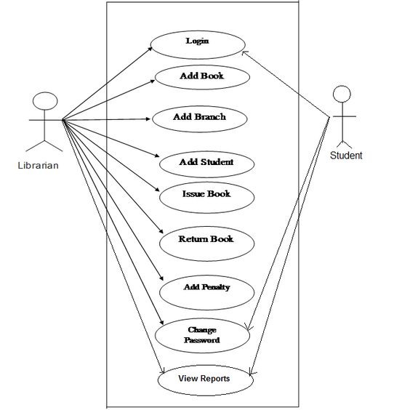
Use case diagram for Library Management System

Slide 99
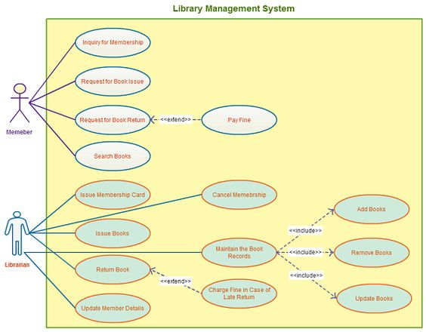

Slide 100
How to Identify Actor
Who uses the system?
Who installs the system?
Who starts up the system?
Who maintains the system?
Who shuts down the system?
Who gets information from this system?
Who provides information to the system?

Slide 101
How to Identify Use Cases?
What functions will the actor want from the system?
Does the system store information? What actors will create, read, update or delete this information?
Does the system need to notify an actor about changes in the internal state?
Are there any external events the system must know about? What actor informs the system of those events?

Slide 102
Representation
A case is often represented in a plain text or a diagram. Due to the simplicity of the use case diagram, it is considered to be optional by any organization

Slide 103
Example
Here we will discuss the case for ‘Login’ to a ‘School Management System’.
Use Case Name ------------ Login
Use case Description------ A user login to System to access the functionality of the system.
Actors------------Parents, Students, Teacher, Admin
Pre-Condition--------System must be connected to the network.
Post –Condition------- After a successful login a notification mail is sent to the User mail id

Slide 104
Use Case Testing
It comes under the Functional Black Box testing technique.
As it is a black box testing, there won’t be any inspection of the codes.
It ensures if the path used by the user is working as intended or not. It makes sure that the user can accomplish the task successfully.

Slide 105
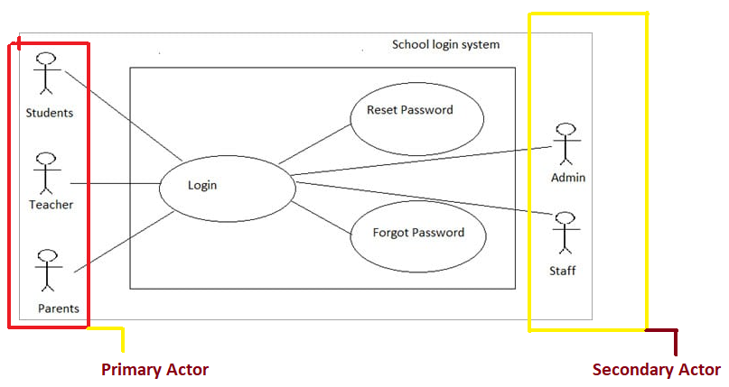

Slide 106
Test Case Example
Test Cases Steps Expected Result
Enter Student Name User can enter
Student name
2 Enter Student ID User can enter Student ID
3 Click on View Mark System displays Student Marksfor ‘Show Student Marks’ case

Slide 107
Requirement Analysis Steps
Draw the context diagram
Develop Prototype
Model the requirement
Finalized the requirements

Slide 108
Requirement Analysis Steps(cont..)
:
It is a simple diagram.
It defines interface and boundaries of system with external environment.
It identifies the entities outside the proposed system, which interact with the system
Draw the context diagram

Slide 109
Context diagram….
subject entry marks entry operator
marks entry
administrator
performance report
mark sheet generation
subject report
Result Management

Slide 110
Develop Prototype
One effective way to find out the customer’s expectation is to construct a prototype.
Customer’s feedback can be used to modify the prototype until the customer is satisfied
In case where developers and users are not sure about some of the elements, a prototype may help both the parties to take a final decision.

Slide 111
Model the requirement
This process generally consists of various graphical representations of the functions, data entities, external entities, and the relationships between them.

Slide 112
Finalized the requirements
After framing the requirements, we will have a better understanding of the system behavior.
The inconsistencies and ambiguities have been identified and corrected.
The flow of data amongst various modules has been analyzed.
Elicitation and analyze activities have provided better insight into the system.
After that we finalize the analyzed requirements, and the next step is to prepare documentation in proper way.

Slide 113
Data Flow Diagram
It shows the flow of data through system.
All names should be unique
It shows how the data enter and leaves the system and where data is stored.
The objective of DFD is to show the scope and boundaries of a system as whole.
It is also called data flow graph or bubble chart.

Slide 114
Standard symbols of Data flow diagram
Symbol Name Function
It is used to connect processes with each other
Data Flow
Perform transformation of its input data to output data
Process
Source or sink
Data Store
A source of system inputs or sink of system outputs
A repository of data a arrow head indicate net input and net output of data

Slide 115
Levels in Data Flow Diagrams (DFD)
0-level DFDM
It is also known as fundamental system model, or context diagram represents the entire software requirement as a single bubble with input and output data denoted by incoming and outgoing arrows.
Then the system is decomposed and described as a DFD with multiple bubbles. Parts of the system represented by each of these bubbles are then decomposed and documented as more and more detailed DFDs.

Slide 116
0-level DFDM(continue)
This process may be repeated at as many levels as necessary until the program at hand is well understood.
It is essential to preserve the number of inputs and outputs between levels, this concept is called leveling by DeMacro. Thus, if bubble "A" has two inputs x₁ and x₂ and one output y, then the expanded DFD, that represents "A" should have exactly two external inputs and one external output as shown in fig:

Slide 117
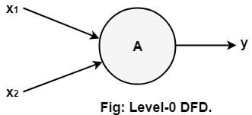
The Level-0 DFD, also called context diagram.

Slide 118
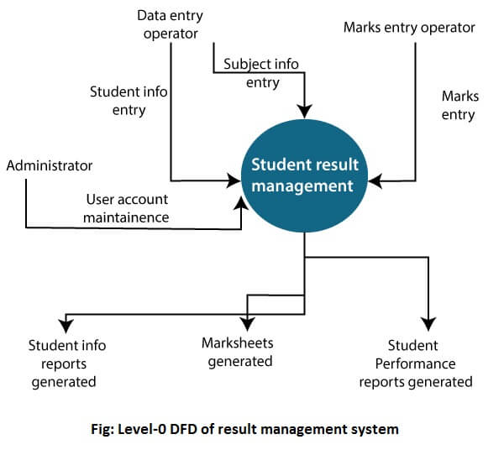

Slide 119
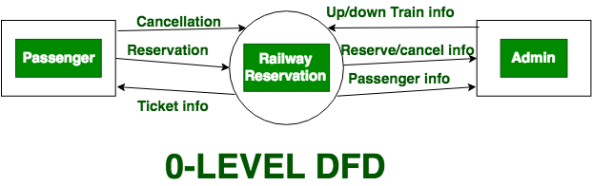

Slide 120
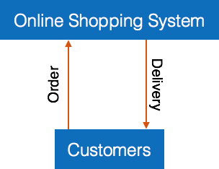

Slide 121
1-level DFD
In 1-level DFD, a context diagram is decomposed into multiple bubbles/processes. In this level,
we highlight the main objectives of the system and breakdown the high-level process of 0-level DFD into sub processes.

Slide 122
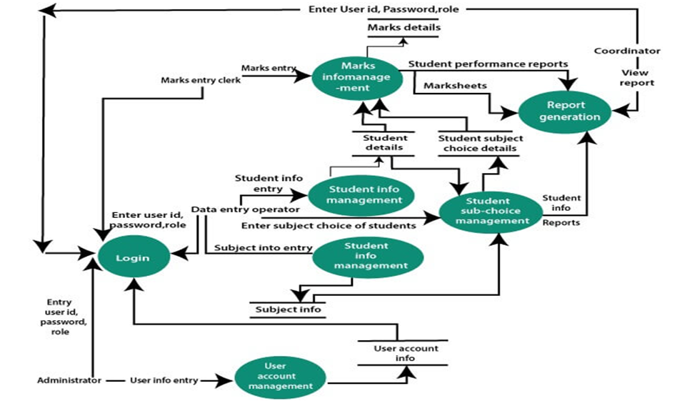

Slide 123
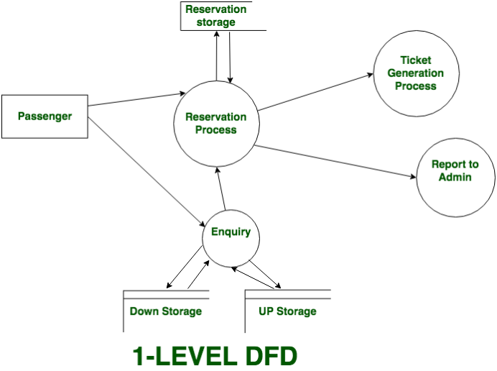

Slide 124
2-Level DFD
2-level DFD goes one process deeper into parts of 1-level DFD. It can be used to project or record the specific/necessary detail about the system's functioning.

Slide 125
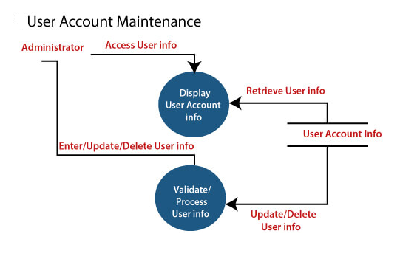

Slide 126
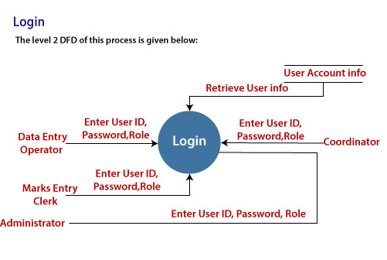

Slide 127

Subject Name Software Engineering
Requirement
Documentation

Slide 128
Requirement
Documentation
Important activity after requirement gathering.
It is also known as Software Requirement Specification (SRS).
It serves number of purposes.
Increase customer satisfaction level.

Slide 129
Nature of SRS
Functionality
External Interfaces
Performance
Attributes
Design constraints imposed on an implementation

Slide 130
Characteristics of a good SRS
The SRS should be:
Correct
Unambiguous
Complete
Consistent

Slide 131
Characteristics of a good SRS
Ranked for importance and/or stability
Verifiable
Modifiable
Traceable

Slide 132
Organization of SRS
IEEE has published guidelines & standards to organize an SRS document.
Different projects may require their requirements to be organized differently.

Slide 133
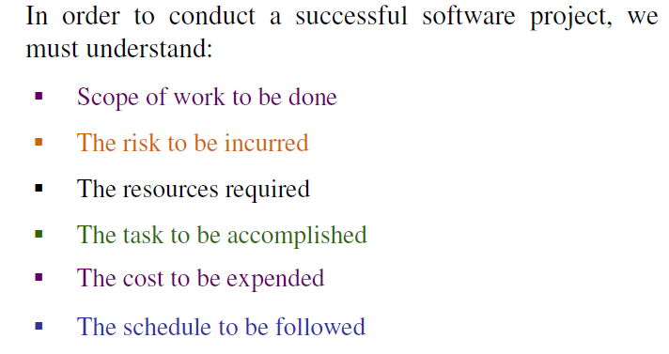
Cont……

Slide 134

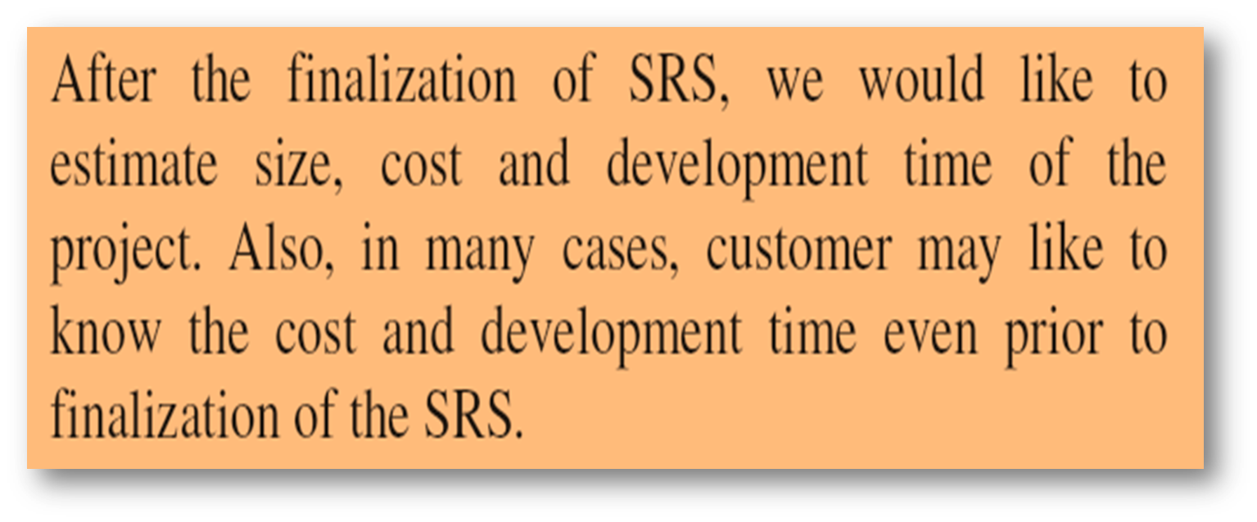

Slide 135

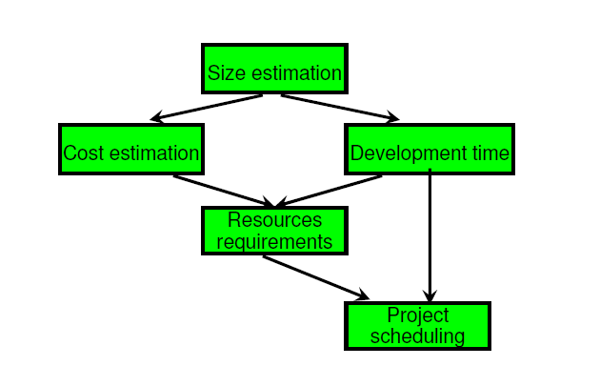

Cont….

Slide 136
Project size estimation techniques
Estimation of the size of software is an essential part of Software Project Management. It helps the project manager to further predict the effort and time which will be needed to build the project. Various measures are used in project size estimation. Some of these are:
Lines of Code
Number of entities in ER diagram
Total number of processes in detailed data flow diagram
Function points

Slide 137


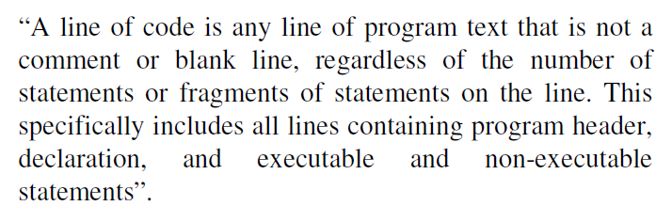

Slide 138
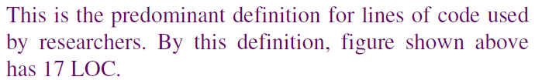
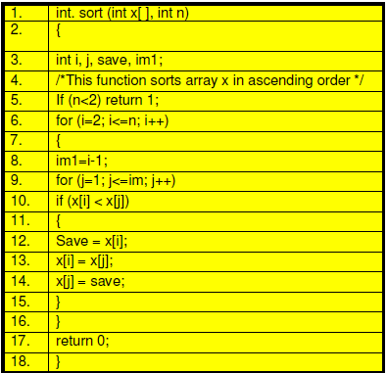

Slide 139
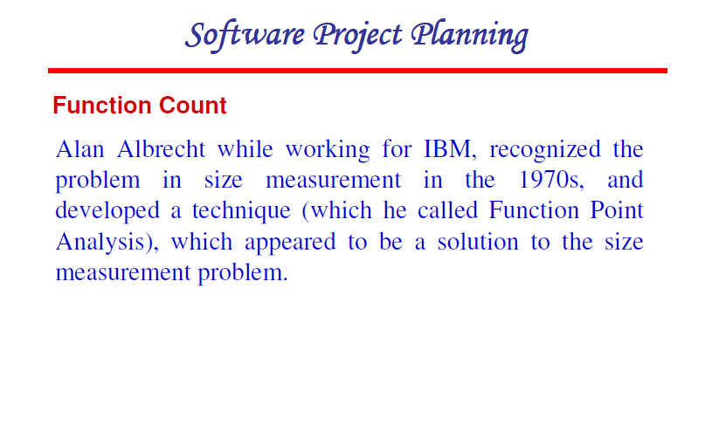

Slide 140
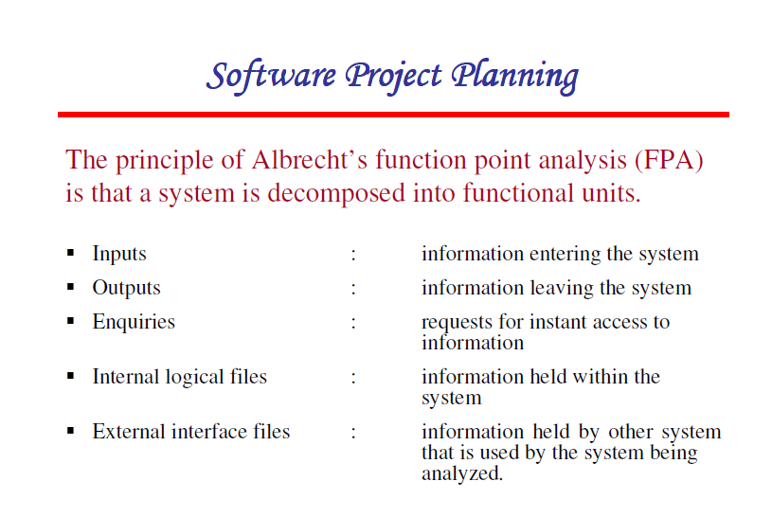

Slide 141
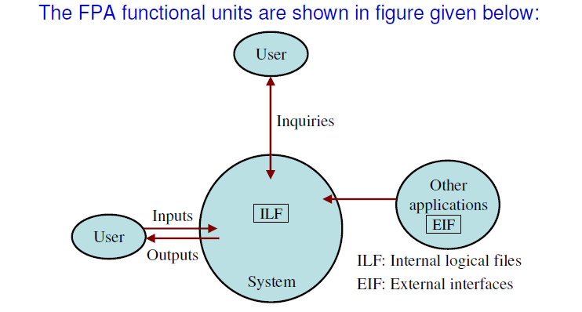

Slide 142
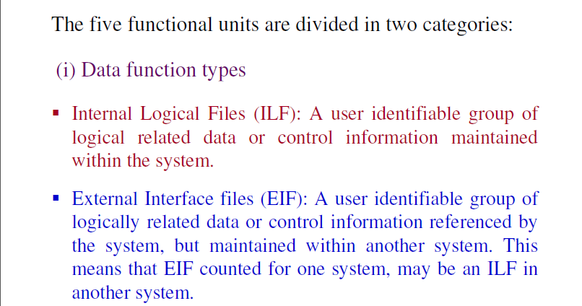

Slide 143
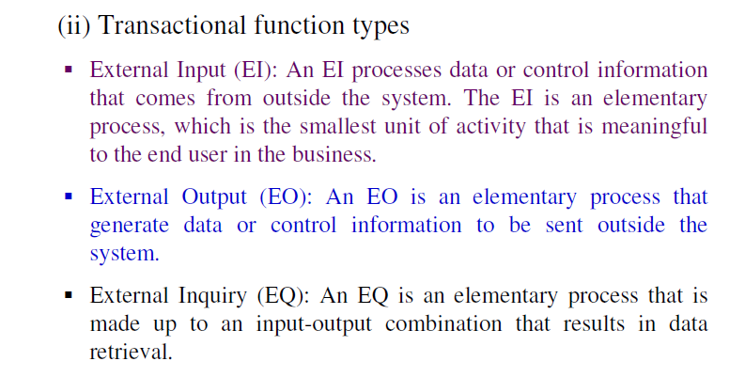

Slide 144
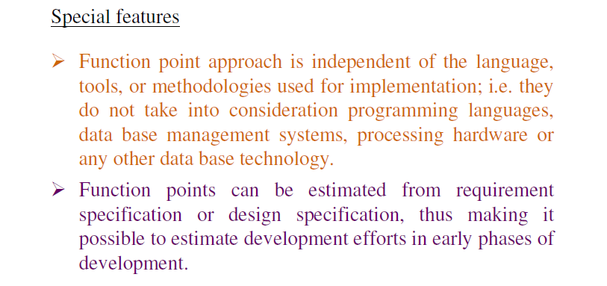

Slide 145
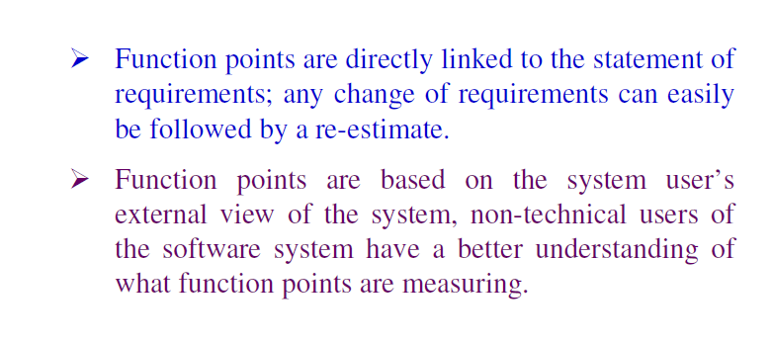

Slide 146
Calculation of Function Point
Calculate Function Point.FP = UFP * CAF
Where,UFP=unadjusted function point
Complexity Adjustment Factor (CAF).
CAF = 0.65 + ( 0.01 * F )
Where F=14*Scale, and scale can be calculated
0 - No Influence
1 - Incidental
2 - Moderate
3 - Average
4 - Significant
5 - Essential

Slide 147
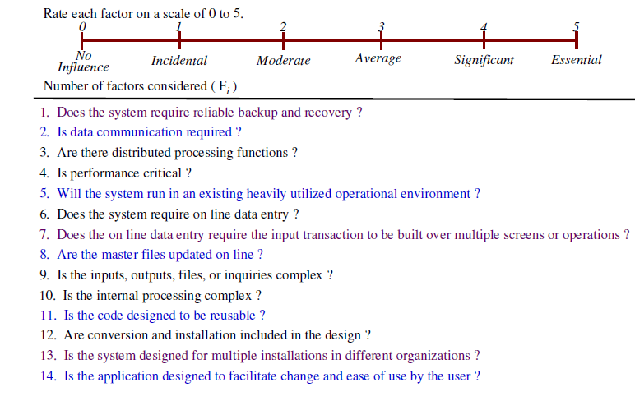

Slide 148
Calculate Unadjusted Function Point (UFP).
FUNCTION UNITS | LOW | AVG | HIGH
EI | 3 | 4 | 6
EO | 4 | 5 | 7
EQ | 3 | 4 | 6
ILF | 7 | 10 | 15
EIF | 5 | 7 | 10
Multiply each individual function point to corresponding values in TABLE.

Slide 149
Ex-1(Calculation of Functional Point)
Given the following values, compute function point when all complexity adjustment factor (CAF) and weighting factors are average.
User Input = 50 User Output = 40 User Inquiries = 35 User Files = 6 External Interface = 4

Slide 150
Step-1: As complexity adjustment factor is average (given in question), hence, scale = 3.
F = 14 * 3 = 42
Step-2:CAF = 0.65 + ( 0.01 * 42 ) = 1.07
Step-3: As weighting factors are also average (given in question) hence we will multiply each individual function point to corresponding values in TABLE.
UFP = (50*4) + (40*5) + (35*4) + (6*10) + (4*7) = 628
Step-4:Function Point = 628 * 1.07 = 671.96

Slide 151
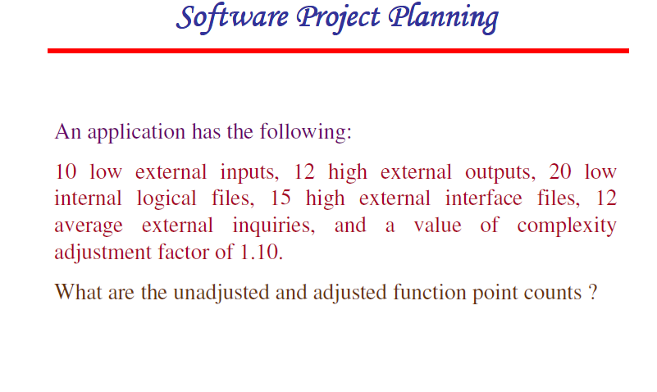

Slide 152
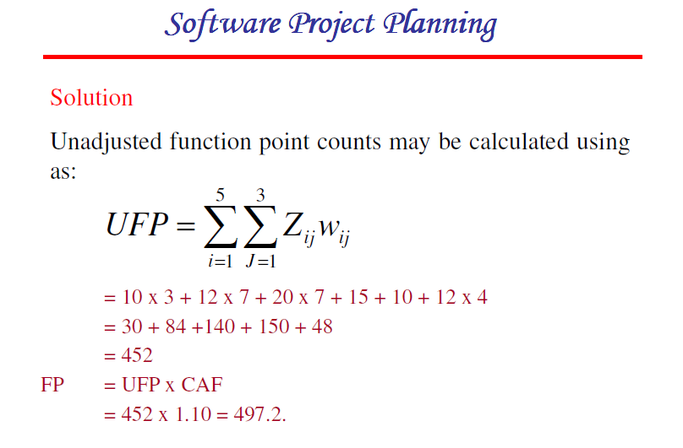


Slide 153
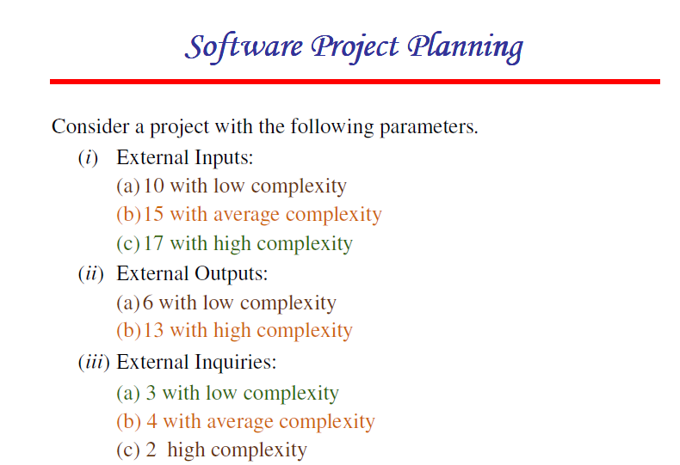

Slide 154
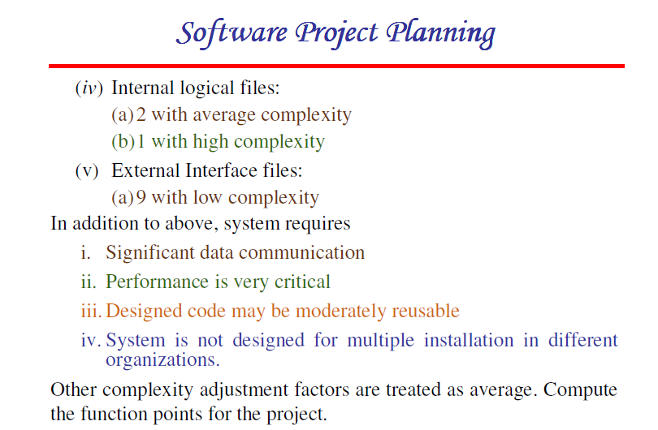

Slide 155
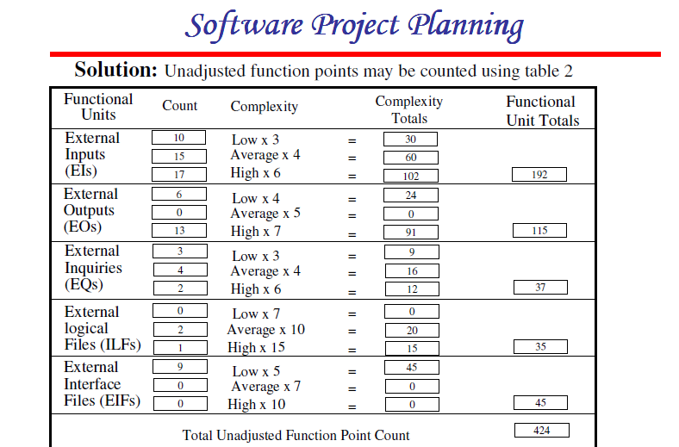

Slide 156
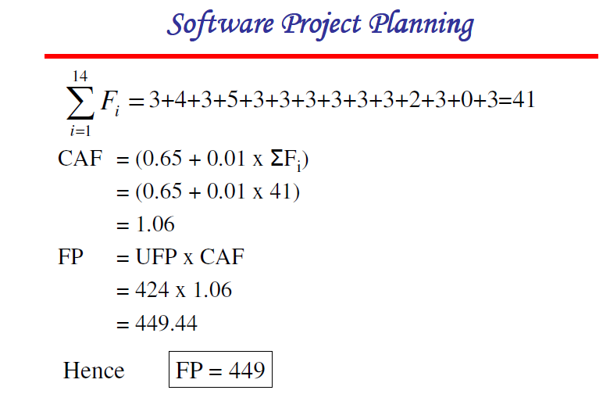

Slide 157
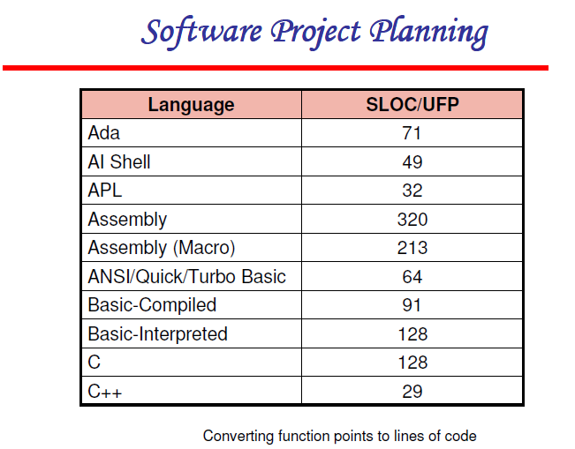

Slide 158
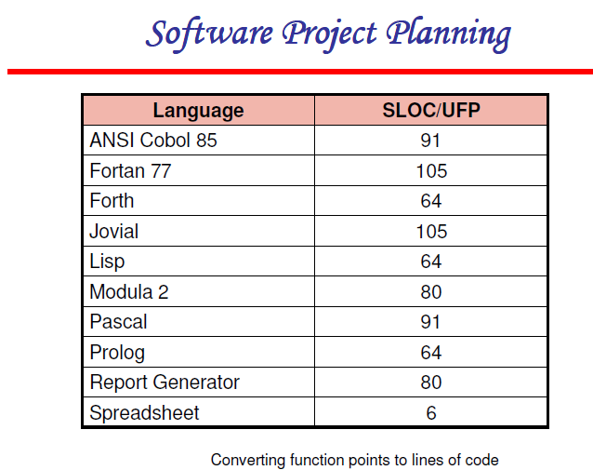

Slide 159
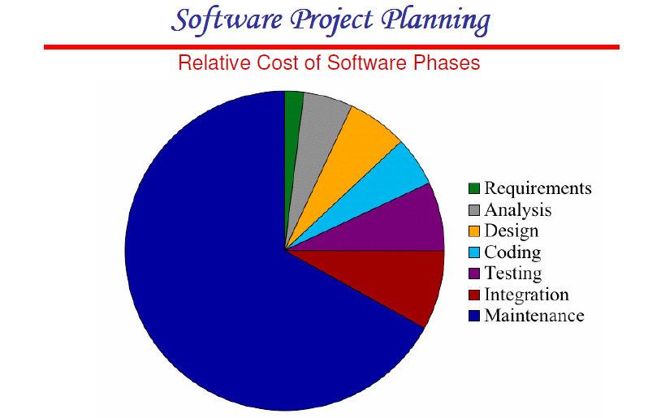

Slide 160
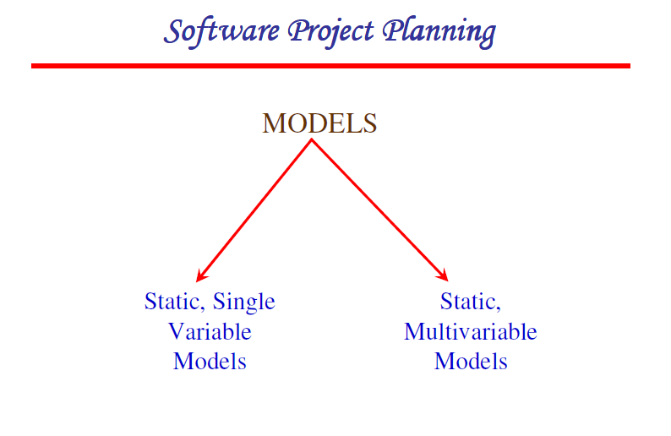

Slide 161
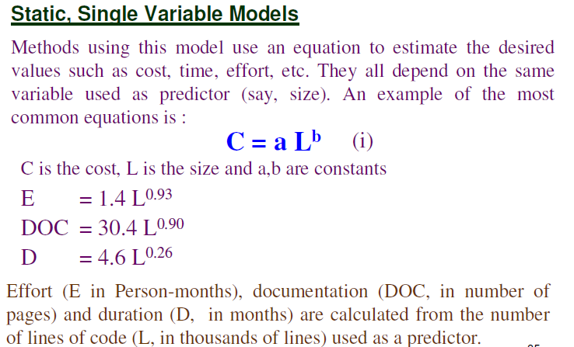
The Software Engineering Laboratory established a model called SEL model, for estimating its software production. This model is an example of the static, single variable model.

Slide 162
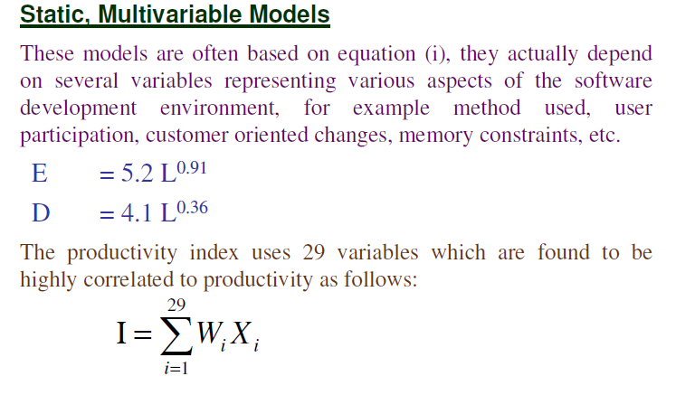
Where W_{i} is the weight factor for the i^{th}variable and X_{i}={-1,0,+1} the estimator gives X_{i}one of the values -1, 0 or +1 depending on the variable decreases, has no effect or increases the productivity.
WALSTON and FELIX develop the models at IBM.

Slide 163


Slide 164


Slide 165


Slide 166
Types of Models:
COCOMO consists of a hierarchy of three increasingly detailed and accurate forms.
Any of the three forms can be adopted according to our requirements.
These are types of COCOMO model:
  Basic COCOMO Model
  Intermediate COCOMO Model
  Detailed COCOMO Model

Slide 167




Slide 168



Slide 169


Slide 170


Slide 171


Slide 172


Slide 173


Slide 174


Slide 175


Slide 176
Intermediate Model
The basic COCOMO model considers that the effort is only a function of the number of lines of code and some constants calculated according to the various software systems. The intermediate COCOMO model recognizes these facts and refines the initial estimates obtained through the basic COCOMO model by using a set of 15 cost drivers based on various attributes of software engineering.

Slide 177
Classification of Cost Drivers and their attributes
(i) Product attributes -
Required software reliability extent
Size of the application database
The complexity of the product
Hardware attributes -
Run-time performance constraints
Memory constraints
The volatility of the virtual machine environment
Required turnabout time

Slide 178
Personnel attributes -
Analyst capability
Software engineering capability
Applications experience
Virtual machine experience
Programming language experience
Project attributes -
Use of software tools
Application of software engineering methods
Required development schedule

Slide 179
COST DRIVERS | VERY LOW | LOW | NOMINAL | HIGH | VERY HIGH
Product Attributes
Required Software Reliability | 0.75 | 0.88 | 1.00 | 1.15 | 1.40
Size of Application Database |  | 0.94 | 1.00 | 1.08 | 1.16
Complexity of The Product | 0.70 | 0.85 | 1.00 | 1.15 | 1.30

Slide 180
COST DRIVERS | VERY LOW | LOW | NOMINAL | HIGH | VERY HIGH
Hardware Attributes
Runtime Performance Constraints |  |  | 1.00 | 1.11 | 1.30
Memory Constraints |  |  | 1.00 | 1.06 | 1.21
Volatility of the virtual machine environment |  | 0.87 | 1.00 | 1.15 | 1.30
Required turnabout time |  | 0.94 | 1.00 | 1.07 | 1.15

Slide 181
COST DRIVERS | VERY LOW | LOW | NOMINAL | HIGH | VERY HIGH
Personnel attributes
Analyst capability | 1.46 | 1.19 | 1.00 | 0.86 | 0.71
Applications experience | 1.29 | 1.13 | 1.00 | 0.91 | 0.82
Software engineer capability | 1.42 | 1.17 | 1.00 | 0.86 | 0.70
Virtual machine experience | 1.21 | 1.10 | 1.00 | 0.90
Programming language experience | 1.14 | 1.07 | 1.00 | 0.95

Slide 182
COST DRIVERS | VERY LOW | LOW | NOMINAL | HIGH | VERY HIGH
Project Attributes
Application of software engineering methods | 1.24 | 1.10 | 1.00 | 0.91 | 0.82
Use of software tools | 1.24 | 1.10 | 1.00 | 0.91 | 0.83
Required development schedule | 1.23 | 1.08 | 1.00 | 1.04 | 1.10

Slide 183


Slide 184


Slide 185


Slide 186
The project manager is to rate these 15 different parameters for a particular project on a scale of one to three. Then, depending on these ratings, appropriate cost driver values are taken from the above table.
These 15 values are then multiplied to calculate the EAF (Effort Adjustment Factor).

Slide 187
Detailed COCOMO Model
Detailed COCOMO incorporates all characteristics of the intermediate version with an assessment of the cost driver’s impact on each step of the software engineering process. The detailed model uses different effort multipliers for each cost driver attribute. In detailed cocomo, the whole software is divided into different modules and then we apply COCOMO in different modules to estimate effort and then sum the effort.

Slide 188


Slide 189


Slide 190



Slide 191


Slide 192


Slide 193


Slide 194







Slide 195






Slide 196
Problem
Consider a project to develop a full screen editor. The major components
identified are:
I. Screen edit
II. Command Language Interpreter
III. File Input & Output
IV.Cursor Movement
V. Screen Movement
The size of these are estimated to be 4k, 2k, 1k, 2k and 3k delivered source
code lines. Use COCOMO to determine
1. Overall cost and schedule estimates (assume values for different
cost drivers, with at least three of them being different from 1.0)
2. Cost & Schedule estimates for different phases.

Slide 197
Size of five modules are:
Screen edit = 4 KLOC
Command language interpreter = 2 KLOC
File input and output = 1 KLOC
Cursor movement = 2 KLOC
Screen movement = 3 KLOC
Total = 12 KLOC

Slide 198


i. Required software reliability is high, i.e.,1.15
ii. Product complexity is high, i.e.,1.15
iii. Analyst capability is high, i.e.,0.86
iv. Programming language experience is low,i.e.,1.07
v. All other drivers are nominal
EAF = 1.15x1.15x0.86x1.07 = 1.2169

Slide 199



Slide 200


Slide 201

Topic: Function Oriented Design

Slide 202
Content
Software Design
Problem Partitioning
Abstraction
Strategy of Design
  Bottom Up Design
  Top Down Design
  Hybrid Approach

Slide 203
Software Design
Software Design is more creative process than analysis as it deals with the development of the actual mechanics for a new workable system.
Design is a problem solving activity.
Designers with users has to search for a solution until a satisfactory solution has been found.
Design is a phase where designers plans “How” a software system should be produced.

Slide 204
Problem Partitioning
For solving larger problems, the basic principle is “Divide & Conquer”.
The idea behind this principle is to divide the problems into smaller & manageably pieces, so that each piece can be conquered separately.
These different pieces can not be entirely independent of each other, as they together form the system.
These different pieces have to cooperate & communicate to solve the larger problem.
The designer has to make the judgement about when to stop partitioning.

Slide 205
Abstraction
An abstraction of a component describes the external behavior of that component.
Abstraction is an indispensable part of the design process & is essential for problem partitioning.
Abstraction is used for existing components as well as the components that are being designed.
During the design process, abstractions are used in the reverse manner than in the process of understanding a system.
There are two common abstraction mechanism for software system:
  Functional abstraction
  Data abstraction

Slide 206
Strategy of Design
A good system design strategy is to organize the program modules in such a way that are easy to develop and latter to, change.
Structured design techniques help developers to deal with the size and complexity of programs.
Analysts create instructions for the developers about how code should be written and how pieces of code should fit together to form a program.

Slide 207
Strategy of Design
There are many strategies or techniques for performing system design. They include:
Bottom Up Design
Top Down Design &
Hybrid Approach

Slide 208
Bottom Up Design
The bottom up design model starts with most specific and basic components.
It proceeds with composing higher level of components by using basic or lower level components.
It keeps creating higher level components until the desired system is not evolved as one single component.
With each higher level, the amount of abstraction is increased.
Bottom-up strategy is more suitable when a system needs to be created from some existing system, where the basic primitives can be used in the newer system.

Slide 209

Bottom Up Design

Slide 210
Top Down Design
Top-down design takes the whole software system as one entity and then decomposes it to achieve more than one sub-system or component based on some characteristics.
Each sub-system or component is then treated as a system and decomposed further.
This process keeps on running until the lowest level of system in the top-down hierarchy is achieved.
Top-down design is more suitable when the software solution needs to be designed from scratch and specific details are unknown.

Slide 211

Top Down Design

Slide 212
Hybrid Approach
Pure top-down or pure bottom-up approaches are often not practical.
For a bottom-up approach to be successful, we must have a good notion of the top to which the design should be heading.
Hybrid approach is a combination of both the top – down and bottom – up design strategies. In this we can reuse the modules.

Slide 213

Hybrid Approach

Slide 214
References
K.K. Aggarwal and Yogesh Singh, “Software Engineering”, Third Ed., New Age International (P) Limited Publishers. (2009).
Pankaj Jalote, “An Integrated Approach to Software Engineering”, Third Ed., Narose Publishing House, (2008).
Rajib Mall, “Fundamentals of Software Engineering”, Fourth Ed., PHI Learning Private Limited, (2016).
Roger S. Pressman, “Software Engineering: A Practitioner’s Approach”, Fifth Ed., McGraw–Hill Higher Education, (2001).

Slide 215
Thank You !!!

Slide 216
Topic: Module Level Concepts: Coupling & Cohesion

Slide 217
Topics to be covered
Module
Modularity
Module Coupling
Module Cohesion &
Relationship between Coupling & Cohesion

Slide 218
Module
A module is a logically separable part of a program.
It is a program unit that is discrete & identifiable with respect to compiling & loading.
In programming terminology, a module can be a macro, a function, a procedure (or subroutine), a process, or a package.
In systems using functional abstraction, a module is usually a procedure of function.

Slide 219
Modularization
Modularization is the process of dividing a software system into multiple independent modules where each module works independently.
There are many advantages of Modularization in software engineering. Some of these are given below:
  Easy to understand the system.
  System maintenance is easy.
  A module can be used many times as their requirements.

Slide 220



Module Coupling
Coupling is the measure of the degree of interdependence between the modules.
A good software will have low coupling.

Slide 221


Module Coupling
For Example,
Consider a case of editing a student record in a “Student Information System”.

Slide 222

Module Coupling: Types
Module Coupling can be classified into 6 different types as follows:
Given two procedures A & B, we can identify number of ways in which they can be coupled.

Slide 223
Module Coupling
Data Coupling:
The dependency between module A and B is said to be data coupled if their dependency is based on the fact they communicate by only passing of data.
Stamp Coupling:
Stamp coupling occurs between module A and B when complete data structure is passed from one module to another.

Slide 224
Module Coupling
Control Coupling:
Module A & B are said to be control coupled if they communicate by passing of control information. This is usually accomplished by means of flags that are set by one module and reacted upon by the dependent module.
External Coupling:
In external coupling, the modules depend on other modules, external to the software being developed or to a particular type of hardware. Ex- protocol, external file, device format, etc.

Slide 225
Module Coupling
Common Coupling:
With common coupling, module A & B have shared data. Global data areas are commonly found in programming languages. Making a change to the common data means tracing back to all the modules which access that data to evaluate the effect of changes.
Content Coupling:
In a content coupling, one module can modify the data of another module or control flow is passed from one module to the other module. This is the worst form of coupling and should be avoided.

Slide 226

Module Cohesion
Cohesion is a measure of the degree to which the elements of the module are functionally related.
A good software design will have high cohesion.

Slide 227

Module Cohesion: Types
Module Cohesion can be classified into 7 different types as follows:

Slide 228
Module Cohesion
Functional Cohesion:
Every essential element for a single computation is contained in the component. A functional cohesion performs the task and functions. It is an ideal situation.
Sequential Cohesion:
An element outputs some data that becomes the input for other element, i.e., data flow between the parts. It occurs naturally in functional programming languages.

Slide 229
Module Cohesion
Communicational Cohesion:
Two elements operate on the same input data or contribute towards the same output data. Example- update record int the database and send it to the printer.
Procedural Cohesion:
Elements of procedural cohesion ensure the order of execution. Actions are still weakly connected and unlikely to be reusable. Ex- calculate student GPA, print student record, calculate cumulative GPA, print cumulative GPA.

Slide 230
Module Cohesion
Temporal Cohesion:
The elements are related by their timing involved. A module connected with temporal cohesion all the tasks must be executed in the same time-span. This cohesion contains the code for initializing all the parts of the system.
Logical Cohesion:
The elements are logically related and not functionally. Ex- A component reads inputs from tape, disk, and network. All the code for these functions is in the same component. Operations are related, but the functions are significantly different.

Slide 231
Module Cohesion
Coincidental Cohesion:
The elements are not related(unrelated).The elements have no conceptual relationship other than location in source code. It is accidental and the worst form of cohesion.

Slide 232

Relationship between Cohesion & Coupling
If the software is not properly modularized, a host of seemingly trivial(normal) enhancement or changes will result into death of the project. Therefore, a software engineer must design the modules with goal of high cohesion and low coupling.
Fig. View of Cohesion & Coupling

Slide 233
References
K.K. Aggarwal and Yogesh Singh, “Software Engineering”, Third Ed., New Age International (P) Limited Publishers. (2009).
Pankaj Jalote, “An Integrated Approach to Software Engineering”, Third Ed., Narose Publishing House, (2008).
Rajib Mall, “Fundamentals of Software Engineering”, Fourth Ed., PHI Learning Private Limited, (2016).
Roger S. Pressman, “Software Engineering: A Practitioner’s Approach”, Fifth Ed., McGraw–Hill Higher Education, (2001).
https://www.geeksforgeeks.org/software-engineering-coupling-and-cohesion/last accessed on 28/8/2020.

Slide 234
Data Flow Diagram
Struc. Design starts with a DFD to capture flow of data in the proposed system.
DFD provides a high level view of the system.
Emphasizes the flow of data through the system.
Ignores procedural aspects.
(Purpose here is different from DFDs used in requirements analysis, thought notation is the same)

Slide 235
Data Flow Diagram
However, there is a fundamental difference between the DFDs drawn during requirements analysis and those drawn during structured design.
In the requirements analysis, a DFD is drawn to model the problem domain. The analyst has little control over the problem, and hence his task is to extract from the problem all the information and then represent it as a DFD.
The DFD during design represents how the data will flow in the system when it is built. In this modeling, the major transforms or functions in the software are decided, and the DFD shows the major transforms that the software will have and how the data will flow through different transforms.

Slide 236
1:Draw Data Flow Diagram
Start with identifying the inputs and outputs
Work your way from inputs to outputs, or vice versa
  If stuck, reverse direction
  Ask: “What transformations will convert the inputs to outputs”
Never try to show control logic.
If thinking about loops, if-then-else, start again
Label each arrow carefully
Ignore minor functions in the start
For complex systems, make DFD hierarchical

Slide 237

Consider the example of the simple automated teller machine that allows customers to withdraw money. A DFD for this ATM is shown in Figure.

Slide 238
There are two major streams of input data in this diagram. The first is the account number and the code, and the second is the amount to be debited. The DFD is self-explanatory. Notice the use of * at different places in the DFD. For example, the transform "validate," which verifies if the account number and code are valid, needs not only the account number and code, but also information from the system database to do the validation. And the transform debit account has two outputs, one used for recording the transaction and the other to update the account.

Slide 239



